Slide 1
Networking Fundamentals
Foundations of Ethernet and IP

Slide 2
TCP and UDP
#
Connection-oriented vs. connectionless protocols

Slide 3
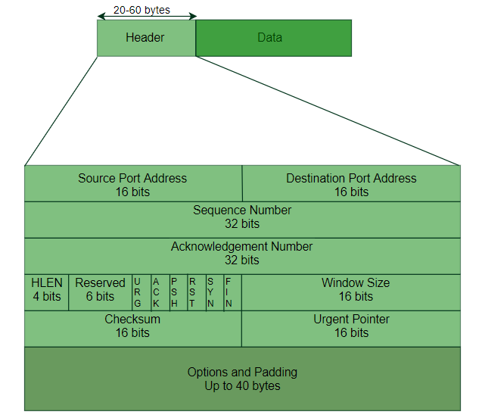
TCP: Introduction
TCP – Transmission Control Protocol
Protocol Data Unit - Segment
Header size – 20-60 Bytes
Starts with random initial sequence number
Includes source and destination IP and port

Slide 4
TCP: Flags
URG – Urgent
Process packet before any non-urgent packets
ACK – Acknowledge
Acknowledge receipt of a sequence number
PSH – Push
Packet processed immediately, not buffered
RST – Reset
Resents connection
SYN – Synchronize
Request to open a TCP connection
FIN – Finished
Indicates sender has no more data to send

Slide 5
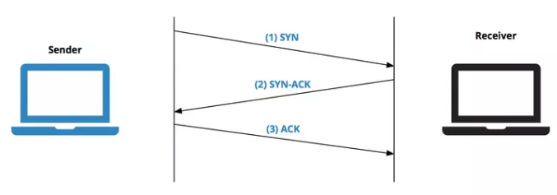
TCP: The 3-Way Handshake
Sender sends initial TCP packet with SYN flag, to request opening a connection
Receiver replies, ACK the initial SYN and sending its own SYN
Sender receives the ACK and SYN, replies with ACK to acknowledge the second SYN
Confirms 2 way communication

Slide 6
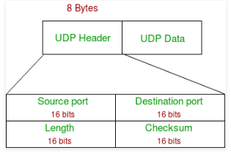
UDP: Introduction
UDP – User Datagram Protocol
Protocol Data Unit - Datagram
Header Size – 8 bytes
Includes source and destination IP and port

